Slide 1

Week-2: Predictive analytics Fundamentals
Ahmed Sabit
Department of Biostatistics,
Johns Hopkins University

Slide 2
Two main ideas of Machine learning
First, we use Testing Data to evaluate Machine Learning methods.
Second, don’t be fooled by how well a Machine Learning method fits the Training Data.
Fitting the Training Data well but making poor predictions, is called the Bias-Variance Tradeoff.
Regardless of algorithms/methods, the most important thing isn’t how fancy it is, but how it performs with Testing Data.

Slide 3
Recap
Testing set and Training set
Cross validation

Slide 4
Why Cross-Validation?
Eliminating the "Lucky Split" (Reliability)
Maximizing Limited Data
Smarter Hyperparameter Tuning
Detecting Overfitting

Slide 5
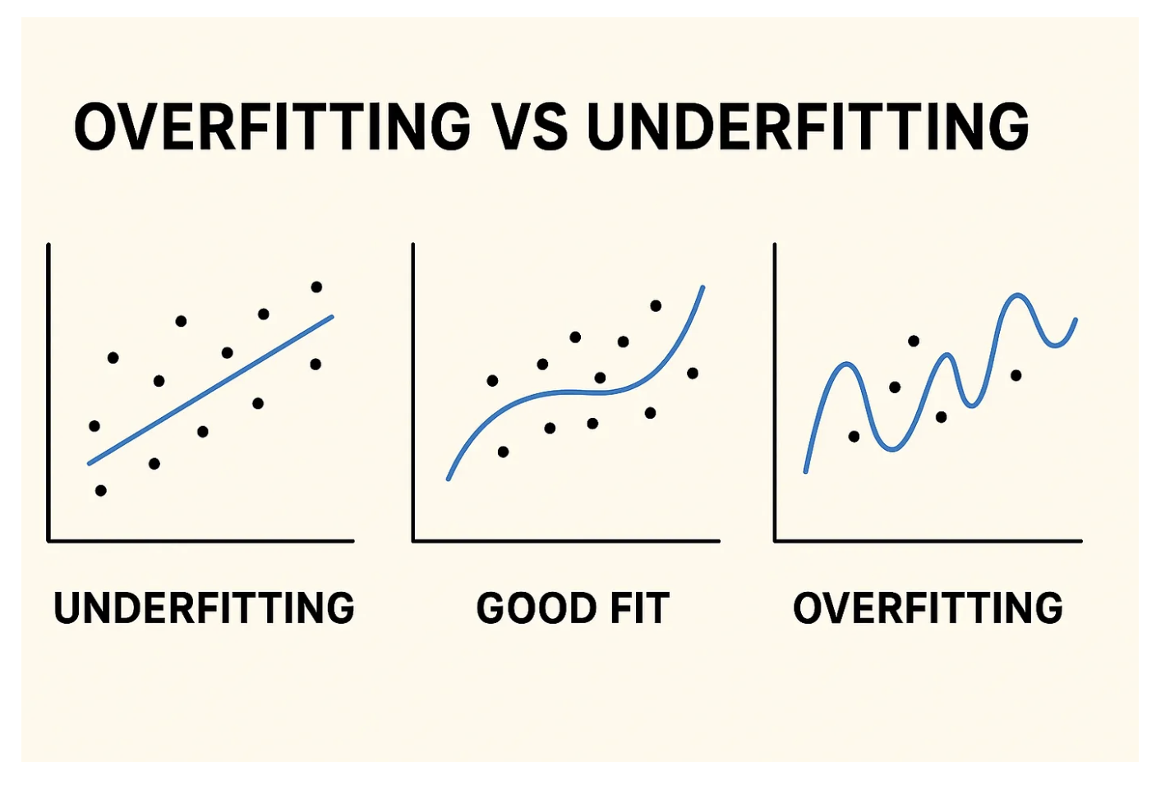
Overfitting
Underfitting → The model hasn’t learned enough.
Overfitting → The model has learned too much (even noise).
Good fit → The model captures the important patterns and ignores the noise.
Source of the graph: https://python.plainenglish.io/overfitting-vs-underfitting-in-machine-learning-the-goldilocks-problem-b8b5232e984e

Slide 6
The Confusion Matrix
How to choose which model works best with out data?
In other words, which model predicts the outcome best?
The work-flow:
Test-Train split
Use Cross-Validation
Train all the methods with the training data
Test each method on the testing set
Summarize how each method performed on testing data

Slide 7
The Confusion Matrix
 |  | Actual
 |  | Has HT | Do not have HT
Predicted | Has HT | True Positive | False Positives
 | Do not have HT | False Negatives | True Negatives
Rows represents what is predicted
Columns predicts what is actual

Slide 8
The Confusion Matrix
True Positives: These are the patients that had HT that were correctly identified by the algorithm.
1
True Negatives: These are the patients that did not have HT that were correctly identified by the algorithm.
2
False Negatives: False Negatives are when a patient has HT, but the algorithm said they didn’t.
3
False Positives : False Positives are patients that do not have HT, but the algorithm says they do.
4

Slide 9
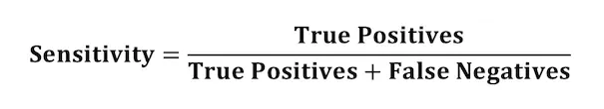
Sensitivity
Sensitivity: Sensitivity tells us what percentage of patients with HT were correctly identified.
 |  | Actual
 |  | Has HT | Do not have HT
Predicted | Has HT | 139 | 20
 | Do not have HT | 32 | 112

Slide 10

Specificity
Specificity: Specificity tells us what percentage of patients without HTwere correctly identified.

Slide 11

Sensitivity vs. Specificity
Which one to use and why?

Slide 12

ROC and AUC
ROC: Receiver Operating Characteristic
AUC: Area under the curve
ROC Definition:
  A ROC Curve is a graphical representation of the performance of a binary classification model for all classification thresholds.

Slide 13
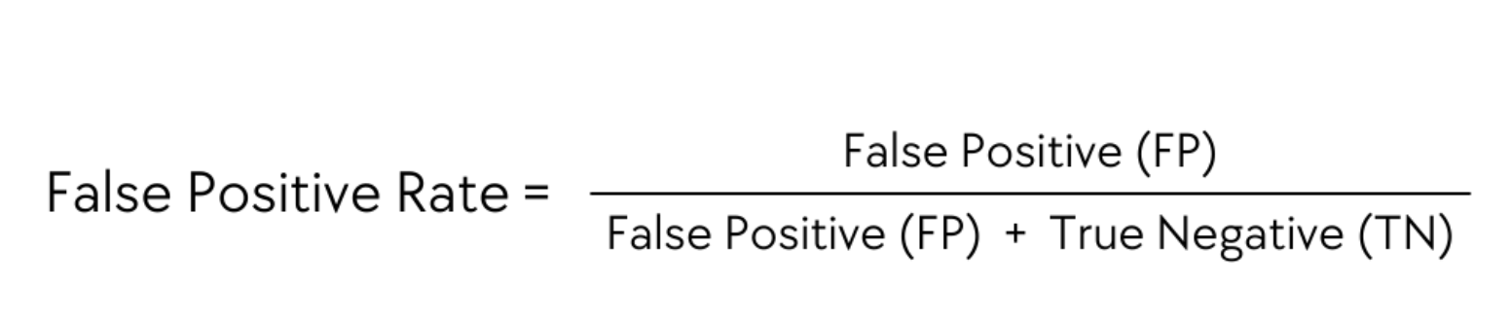
ROC and AUC
True Positive Rate or Sensitivity: What proportion of HT was correctly classified (plotted in y-axis)
False Positive Rate (1 – Specificity): The proportion of actual negative cases that are incorrectly identified as positive (plotted in x-axis)

Slide 14
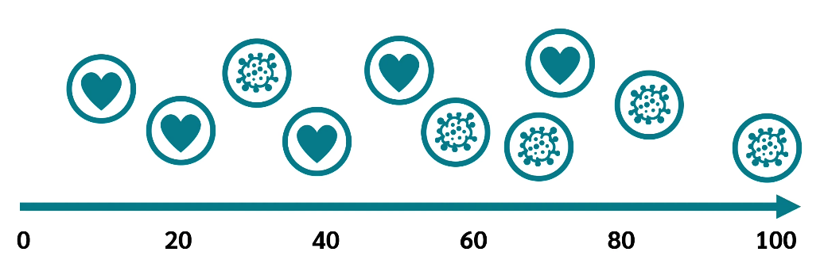
ROC Example
Source: DATAtab

Slide 15
ROC: Selecting the best model
So, the larger the area under the curve, the better the classifier is.
And it is precisely this area that is reflected by the AUC value, the Area under the Curve.

